Slide 1
MASTER THESIS
Laura Aguilar (KTH)
Gawtam Chithra Ramesh (KTH)

Slide 2
Agenda
Supervisors : Matthew Lock and Jonathan Styrud
Manager : Johan Backlund
Problem definition – What are we trying to solve
Pre-requisites – Common concepts
Background – Overview of literature
Our work – How are we solving it

Slide 3

Problem Definition
Pick up the cube
Sampling Path Planner
Formal Specification (Temporal Logic)
AI
AI
Path Planning
Data Driven (Flow Matching)
Notes:
The idea is to take a human command and have the robot execute it.
The biggest trend in robotics is End-to-End AI.
NL to action through a black box with AI (VLAs)
We know their links, motors, the math that drives their dynamics.
Another option: use a logic language to code the NL instruction into a mathematical and precise language.
We still use AI to deal with AMBIGUITY.

Slide 4
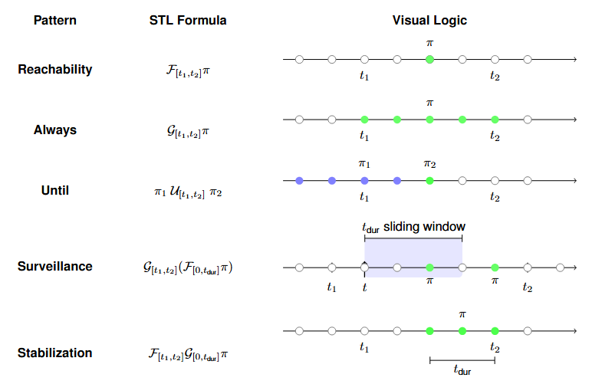
Signal Temporal Logic
Notes:
Is a formal lang used to specify and monitor complex time-dependent requirements.
It combines logical operators (not, and or) and temporal operators.
Gawtam will explain:
- What PI means
- How we can evaluate the math to ensure success

Slide 5
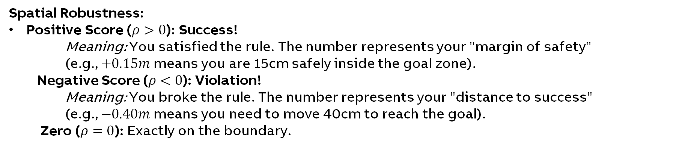
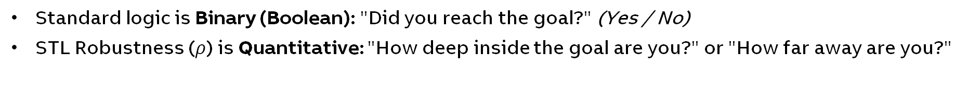
Signal Temporal Logic Evaluation: Robustness
Standard logic is Binary (Boolean): "Did you reach the goal?" (Yes / No)
STL Robustness ($ρ$) is Quantitative: "How deep inside the goal are you?" or "How far away are you?"
Spatial Robustness:
Positive Score ($ρ>0$): Success!
    Meaning: You satisfied the rule. The number represents your "margin of safety" (e.g., $+0.15m$ means you are 15cm safely inside the goal zone).
  Negative Score ($ρ<0$): Violation!
    Meaning: You broke the rule. The number represents your "distance to success" (e.g., $−0.40m$ means you need to move 40cm to reach the goal).
  Zero ($ρ=0$): Exactly on the boundary.

Slide 6
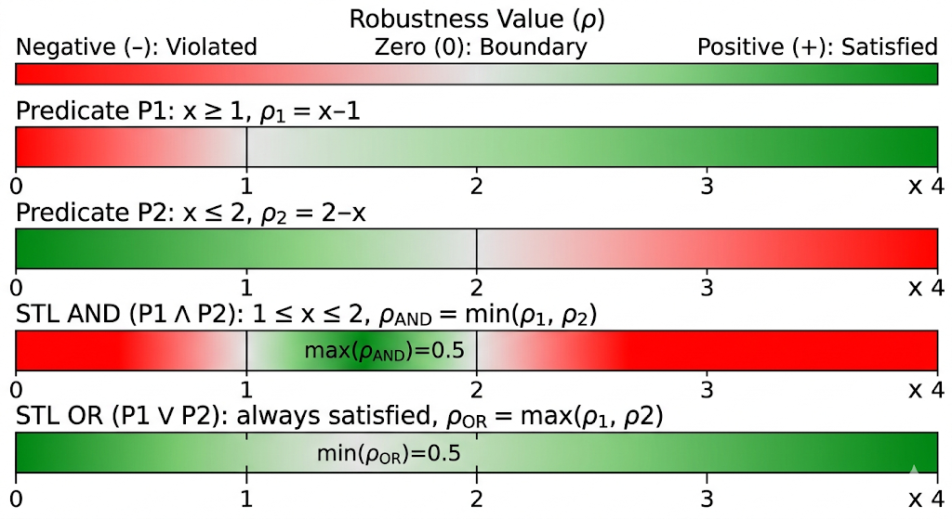
Signal Temporal Logic Evaluation: Robustness
Standard logic is Binary (Boolean): "Did you reach the goal?" (Yes / No)
STL Robustness ($ρ$) is Quantitative: "How deep inside the goal are you?" or "How far away are you?"
Spatial Robustness example :

Slide 7
Signal Temporal Logic Evaluation: Robustness
Standard logic is Binary (Boolean): "Did you reach the goal?" (Yes / No)
STL Robustness ($ρ$) is Quantitative: "How deep inside the goal are you?" or "How far away are you?"
Spatial Robustness example :

Slide 8
Robot Control under STL Constraints
Algorithms
Classical MILP
Sampling-Based
Learning-based
Transforms the entire problem into a mathematical equation and uses classical solvers to solve the optimization problem.
Randomly sample points in space and time, growing a search tree.
Learning STL-Trajectory pairs.
Using robustness as reward for Reinforcement Learning.
Guiding task agnostic pretrained models.
Pro | Formal global optimality | Scalable to complex specifications | Fast execution (front-loading computational costs to the offline training)
Con | Exponential computation | Lack of Optimality Gurantees | Hallucination and Training Data

Slide 9
Laura
Sampling-Based Algorithm

Slide 10
Overview
Thesis topic : Sampling based method for motion planning under STL specifications
Agenda :
  Why Sampling
  Sampling Algorithm
  What have I done
  Current Results

Slide 11
Why sampling?
Algorithms
Classical MILP
Sampling-Based
Learning-based
Transforms the entire problem into a mathematical equation and uses classical solvers to solve the optimization problem.
Randomly sample points in space and time, growing a search tree.
Using robustness as reward for Reinforcement Learning.
Learning STL-Trajectory pairs.
Guiding task agnostic pretrained models.
Notes:
I focused on classical approaches (Gawtam has the learning covered)
Between MILP and sampling: MILP is more popular but used more on mobile robots/drones where the DoF are lower. For higher DoF: sampling surpases the curse of dimensionality. We do not need the best optimized path after long periods of time for planning, we want a path that follows the STL laws and is faster to obtain.

Slide 12
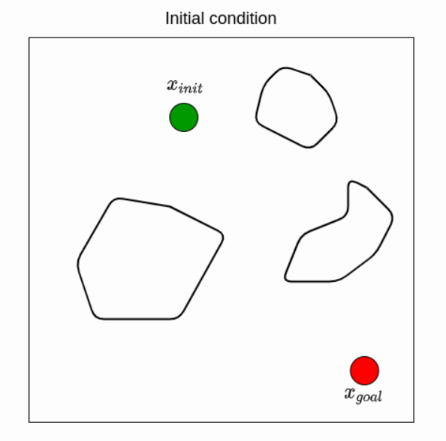
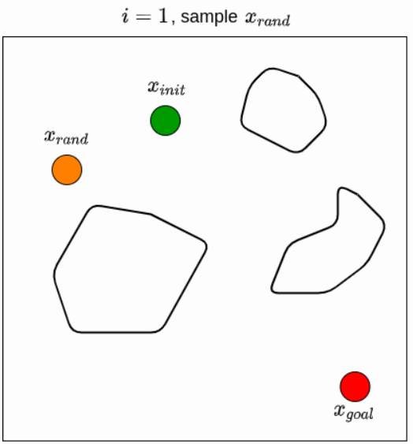
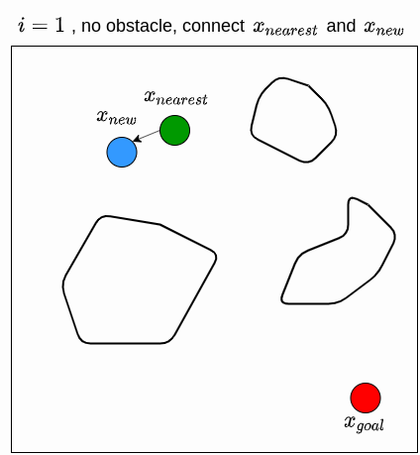
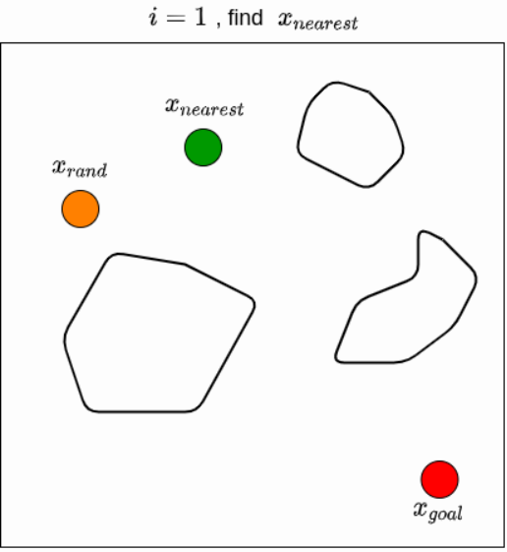
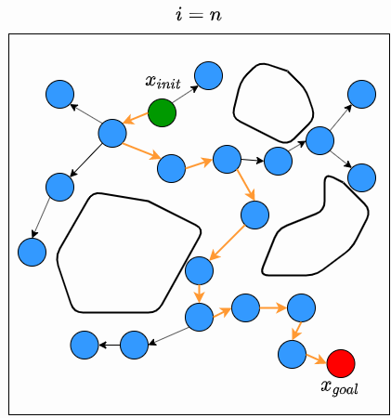
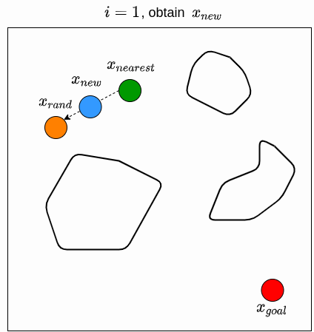
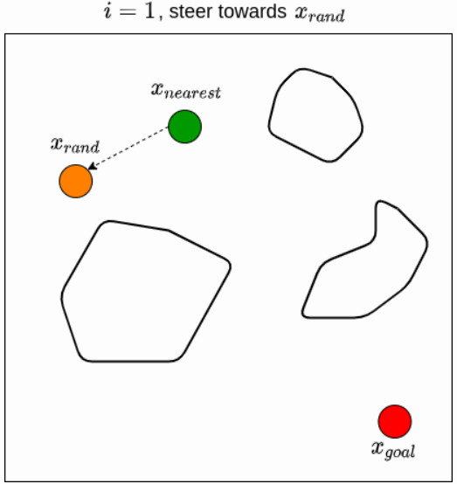
RRT - Rapidly-exploring Random Tree
Quick demonstration of the algorithm
Notes:
RRT explanation

Slide 13
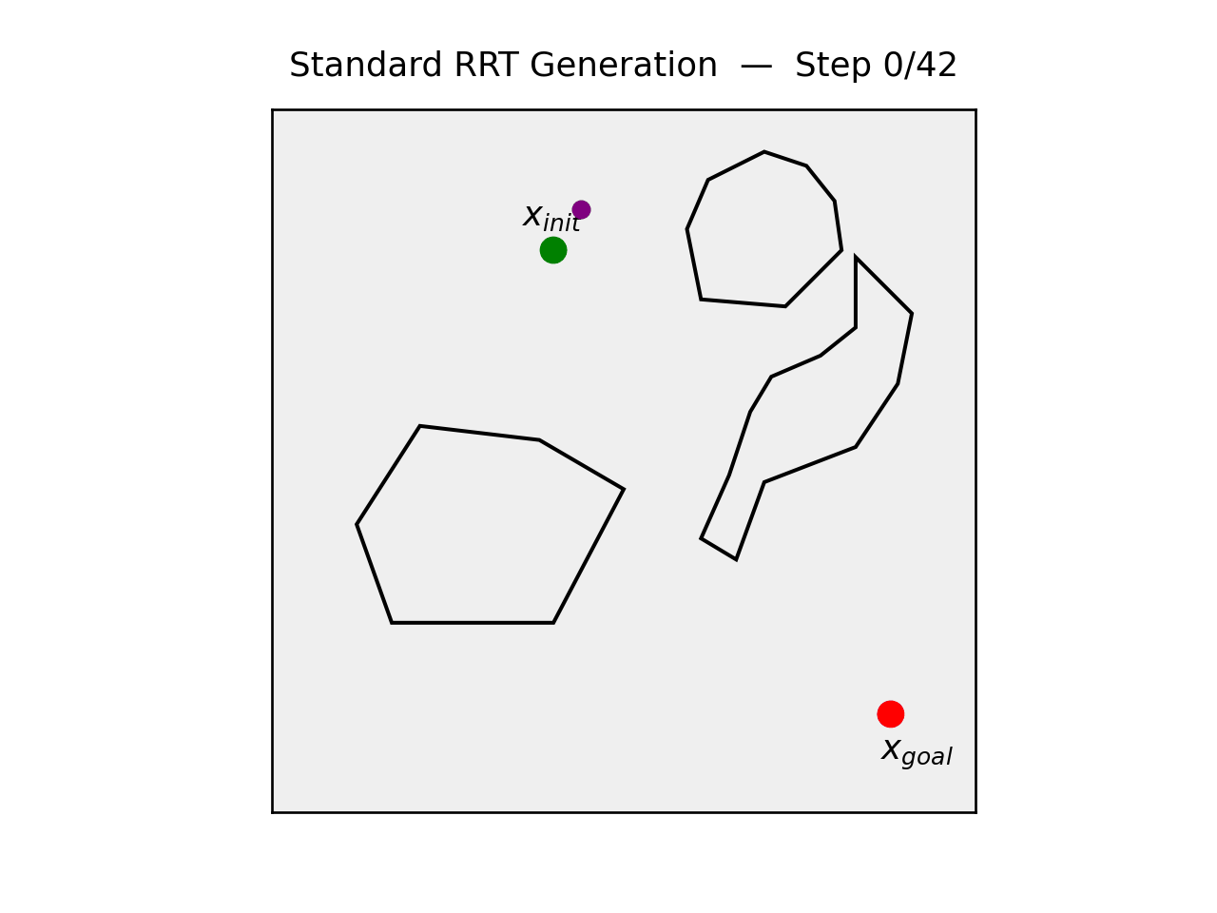
RRT - Rapidly-exploring Random Tree
Quick demonstration of the algorithm
Notes:
RRT explanation

Slide 14
My Planner
Feature | RRT | My implementation
State Space | 3D – Space | 4D – Space + Time
Goal | (X, Y, Z) | STL Formula
Edge Interpolation | Check intermediate points for collisions | Check robustness at time micro-steps
Parent Selection | Euclidean distance | Causal & Logical
Success | Reach goal | Robustness > 0

Slide 15
My Planner: Steps
Sample (x,y,z,t)
Pick random 3D position AND time.
Find Best Parent
Pick the parent with the best STL robustness.
Steer
Steer in Joint Space.
01
02
03
Micro-step STL Check
Interpolate along edge. Update STL monitor.
Terminate on ρ>0
When robustness is positive, full STL is satisfied.
04
05

Slide 16
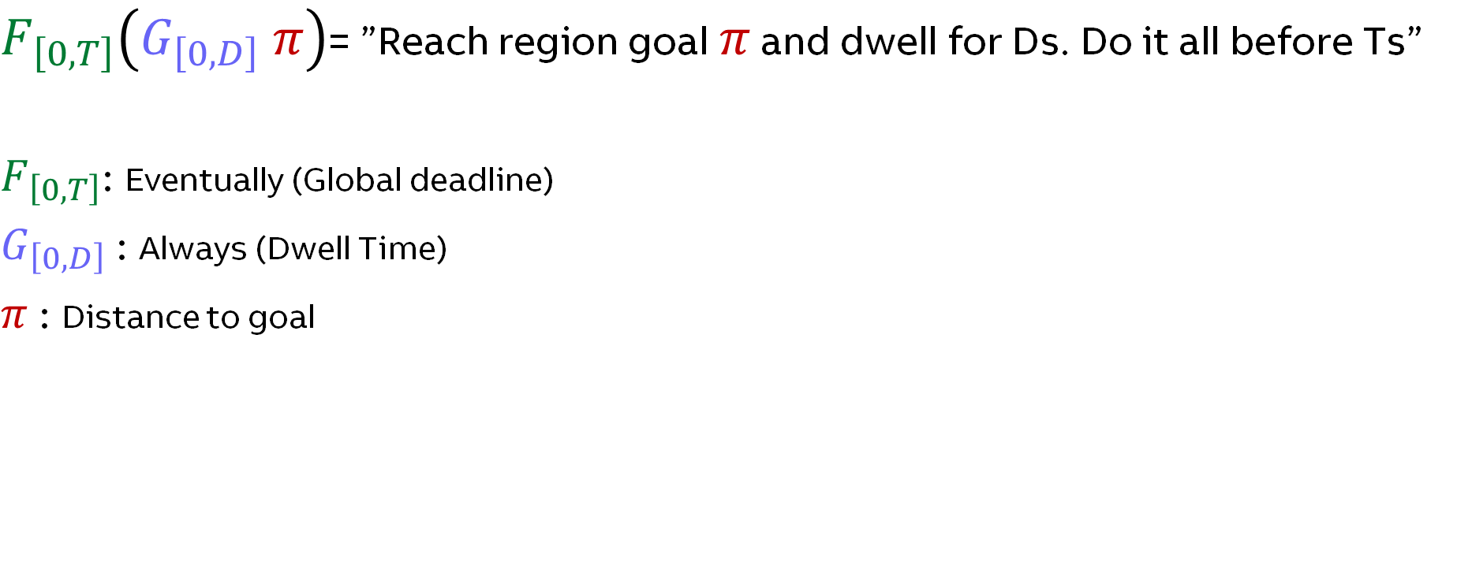
What STL formula are we solving?
$F_{\left[0, T\right]}\left(G_{\left[0, D\right]} π\right)$= ”Reach region goal $π$ and dwell for Ds. Do it all before Ts”
$F_{\left[0, T\right]}$: Eventually (Global deadline)
$G_{\left[0, D\right]}$: Always (Dwell Time)
$π$: Distance to goal
Notes:
We are basically trying to solve this equation which translates to Reach the goal and dwell in it for D seconds. The grasping has been taken out since we are evaluating a continous trajectory and grasping is a discrete action.

Slide 17
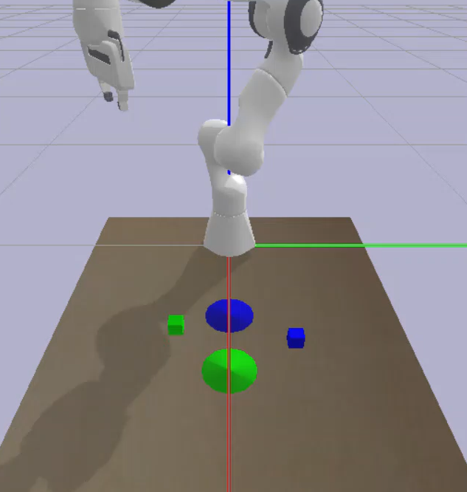
Results
$$F_{\left[0, 6\right]}\left(G_{\left[0, 2\right]} cube1\right) \& F_{\left[7, 12\right]}\left(G_{\left[0, 2\right]} region1\right) \&{ F}_{\left[13, 18\right]}\left(G_{\left[0, 2\right]} cube2\right) \& F_{\left[19, 24\right]}\left(G_{\left[0, 2\right]} region2\right)$$
Problems:
Precomputed time windows
No real ”sequence”

Slide 18
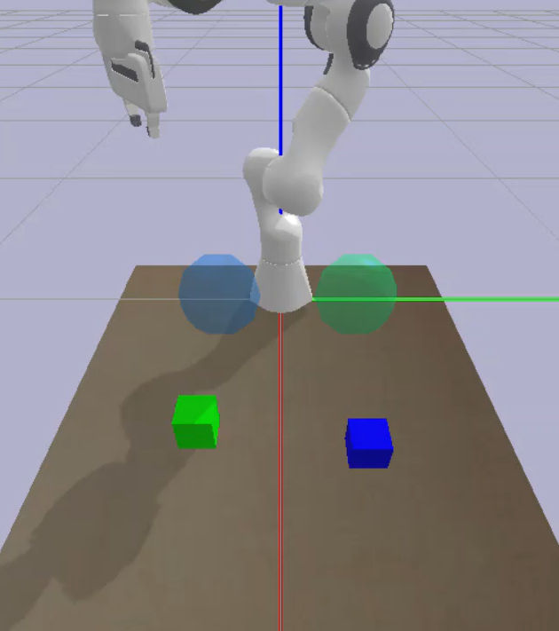
Results
$$F_{\left[0, 6\right]}(G_{\left[0, 2\right]} pick \& F_{\left[0, 6\right]}\left(G_{\left[0, 2\right]} place\right)$$
Problem:
Nested formulas require RELATIVE time evaluations
Solutions
Keep memory on the nodes of Relative Times
Approximate the Eventually-Always (FG) as a continous OR operation of the Always(G)
Solutions
Keep memory on the nodes of Relative Times
Approximate the Eventually-Always (FG) as a continous OR operation of the Always(G)
$$F_{\left[0, 3\right]}\left(G_{\left[0, 1\right]} π\right)=(G_{\left[0, 1\right]} π){ ∨(G}_{\left[1, 2\right]} π)∨{(G}_{\left[2, 3\right]} π)$$
Notes:
Nested formula, video demosntration of the dwell.

Slide 19
Gawtam
Learning-based methods

Slide 20
Overview
Thesis topic : Data driven methods for control under STL specifications
Research Question :
  Can data driven methods leverage formal specifications of STL to generate robust and safe trajectories?
  Specifically,
    Reinforcement learning → (later pivoted to) → Generative models
Agenda :
  Background of learning based method for robotic manipulation.
  How can STL be combined with them
  Why combining with STL make them better
  What have I done

Slide 21
Learning to Manipulate
Generalizability and Safety
1
2
3
Imitation Learning
Reinforcement Learning
Generative Models
Learn from expert
demonstrations. Imitate the closest demonstration.
Learn from trial & error
with a reward signal
Learn trajectory distributions,
generate new ones
Observe picking an object 100 times,
Then mimic my picking
+ve (reward) if you pick,
-ve (penalty) if you collide, …
Understand robot and environment
Generate new scenarios and adapt
Notes:
This is just to give a brief context, there are a lot more methods, each of them can be composed

Slide 22
Learning to Manipulate
Safety??
Generalizability and Safety
Generalizability
1
2
3
Imitation Learning
Reinforcement Learning
Generative Models
Pro : Best, if task is similar to data
(In most cases it is)
Con : You need LOTS of data to generalize
Pro : No need data, agent generates data as it tries
Con : Reward engineering is complex
Pro : Can generalize better
Con : Need data and conditioning
Data (STL-Trajectory pairs)
Data (task agnostic)
Observe picking an object 100 times,
Then mimic my picking
+ve reward if you pick,
-ve if you collide, etc …
Understand robot and environment
Generate new scenarios and adapt
Hypothesis: Can we combine the flexibility of learned models with the formal guarantees of STL?

Slide 23
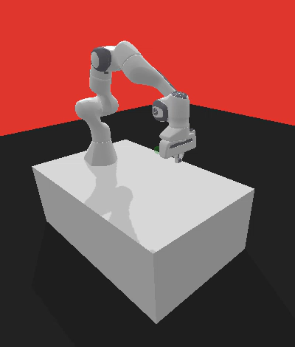
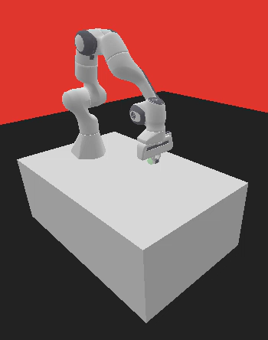

STL Robustness as Reward
Agent
(Policy)
update
action
Reward
Signal
Environment
ρ
State :
R[4] T[4]
Compute
ρ (robustness)
"F[0,10](${\text{Reach}}_{cube}) "$
Notes:
Observations ( P[3], Phase dependent – (T[3], t) )
Rewards
Dense – Robustness (Phase wise)
Sparse - Phase Transition, Goal Completion, Timeout

Slide 24
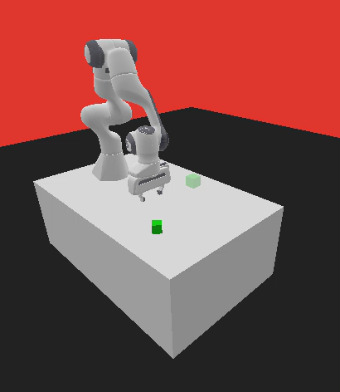
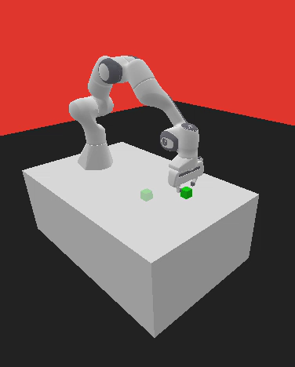

STL Robustness as Reward
Behavior cloning
Exploration vs Exploitation ?
Impact/Need for BC ?
Agent
(Policy)
update
action
Reward
Signal
Environment
Sparse signals
Phase transition, Goal completion,
Timeout
ρ
Dense signals
Augmented States:
R[4], and
Phase dependent : T[4], t
Compute
ρ (phase-wise robustness)
"F[0,10](${\text{Reach}}_{cube}$ ∧ F[0,2](Grasp ∧ F[0,5](${\text{Reach}}_{target}$)))"
✓
Works with composite rewards (Dense and Sparse)
!
Not inherently generalizable : Reward is still ”engineered’ for long horizon tasks.
Motion (reward) is coupled with task. (Good, but is it the best?)
Can we decouple motion generation from the task specification?
Notes:
Motivation to pivot : If you are learning to drive, you don’t need to know every road, of course that’s the best-case scenario (if you are going to drive in the same city)

Slide 25
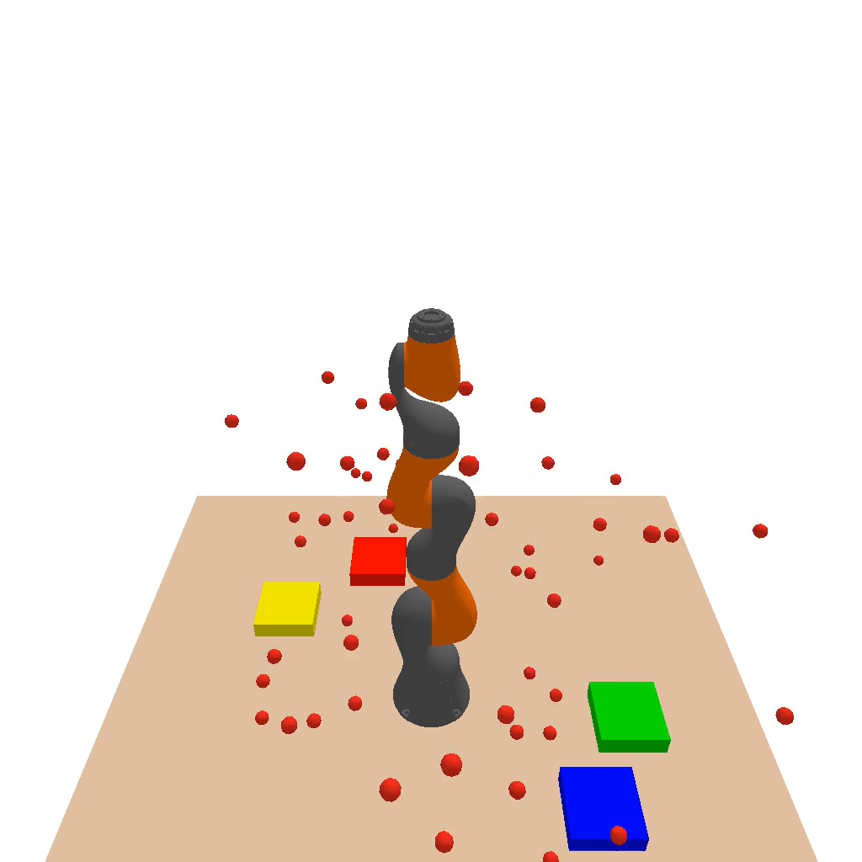
How to “generate” trajectory
Generative models (Diffusion)
TRAINING
Many robot
Demonstrations
Diffusion
model learns
Motion
prior
"What good robot motion looks like"
INFERENCE
Random
noise
Iterative
refinement
Plausible
trajectory
Denoising steps
[ Diffusion denoising ]
Key insight: Task-agnostic motion prior -- knows how robots move, but not what the task is. Fast, flexible, multi-modal.

Slide 26
Guiding “generation" with STL
Flow matching
Diffusion Model
STL Guidance
Safe Trajectory
Generates candidate
trajectories
(motion prior)
Robustness(ρ) modelled as CBFs steers
denoising toward
task satisfaction
Task-satisfying,
formally verified
robot motion
No retraining
Formal guarantees
Separation of concerns
Swap the STL spec at inference
Applied at generation, not baked in training
(Less hallucination, More explainable)
Motion intelligence + logical reasoning, decoupled
Control Barrier Functions (CBFs) enforce reachability and invariance constraints during the denoising process

Slide 28


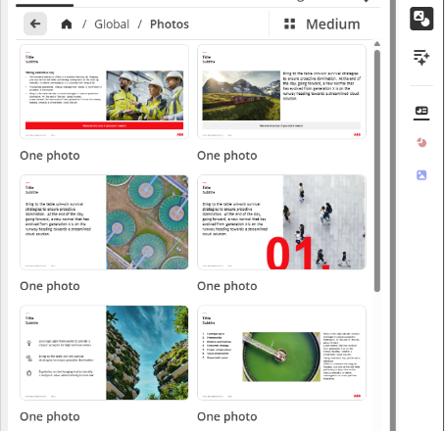

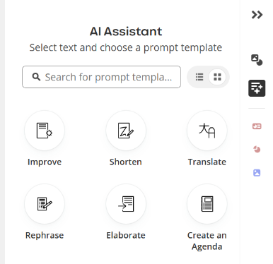



GUIDES
Click the View tab and set tick mark next to Guides
HINT: Alt + F9 for quick view of guides
Mac: ⌘ + option + ctrl + G
—
Getting Started with Templafy at ABB
Access ABB‑approved templates, graphics, slides, and Media Bank images
1
2
3
4
5
6
7
8
9
CHARTS
Color palette for charts is defined under Custom Colors section and should follow specified order.
10
11
12
COPY/PASTE SLIDES
You can move slides between all official ABB templates (including Copilot template) but you have to choose Use Destination Theme to ensure Templafy formatting and update features remain intact.
ABB approved content
Insert brand‑aligned slides, layouts, pictograms, icons, illustrations, and Media Bank images to ensure every presentation follows ABB’s visual identity and uses the latest approved assets.
Resources
Templafy at ABB
Templafy Learning Path
Templafy Training Videos
Sign up for PowerPoint training
User Guide
SLIDES & SLIDE ELEMENTS
Insert predefined slides and elements using the Templafy pane. Choose Slides and Slide elements from the buttons in the Templafy pane on the right side of the screen.
SECURITY LEVEL
Security level (Blank, Confidential, Internal, Public or Strictly Confidential) can be specified in a form during file creation and changed later with Update Presentation option
IMPORTANT!
The security label in Templafy is not automatically changing the Sensitivity Labels on the file, so you will need to do both steps:
1. Add it in Templafy, 2. Change the Sensitivity Label in the fille
Note: This is only needed if the label is not INTERNAL.
AI Assistant
Use prebuilt prompt library to rewrite, shorten, translate, or adjust tone‑of‑voice.
The assistant helps you produce polished and consistent text quickly, aligned with ABB communication standards.
Custom Templafy Space
Do you have templates or assets specific to your business, team, department, function, or country?
You can add them to your own Templafy Space. Request onboarding to get started.
PICTURES
Insert corporate picture from Templafy
Click the blue Templafy button to view Templafy pane on right side of the screen, if it is not already there
Select picture placeholder by clicking on the frame
(at the edge)
Click the Images button in the Templafy pane, or
Choose Media Bank to access the whole collection
One ABB platform for trusted, compliant and intelligent document creation.

